Slide 1


Financial Modeling Best Practices
Confidential
Created by former JP Morgan Investment Bankers, and McKinsey & Deloitte Consultants

Slide 2

Table of contents
What is financial modeling?
What are the most used financial models?
How to design a financial model?
What are the main building blocks used to build a financial model?
How to format a financial model?
What are the key formulas to use in your financial model?
What are the main shortcuts used in financial modelling?
How to handle model circularity issues?

Slide 3
What is financial modeling?
Financial modeling is the task of building an abstract representation of a real-world financial situation
This abstract representation is called a financial model.
A financial model is designed to represent a simplified version of the performance of a company, a project or any other investment.
A financial model is generally built around financial statements such as the income statement, the balance sheet and the cash flow statement.
The most common tool used to build a financial model is Excel.

Slide 4
Table of contents
What is financial modeling?
What are the most used financial models?
How to design a financial model?
What are the main building blocks used to build a financial model?
How to format a financial model?
What are the key formulas to use in your financial model?
What are the main shortcuts used in financial modelling?
How to handle model circularity issues?

Slide 5
What are the most used financial models?
Project Financial Model: Used to estimate the value of a potential project by estimating its Net Present Value (NPV), Return on Investment (ROI) and Internal Rate of return (IRR).
Three Statement Model: Used to forecast a company's income statement, balance sheet, and cash flow statement, and to analyze the financial health of the company.
Discounted Cash Flow (DCF) Model: Used to estimate the value of an investment based on its future cash flows, discounted back to their present value.
A Discounted Earnings Analysis model: Used to estimate the value of an investment based on its future earnings, discounted back to their present value.
A Precedent Transaction Analysis (PTA) Model: Used to determine the valuation of a company based on the valuations of similar companies that have been acquired in the past.
A Comparable Company Analysis (CCA) model: Used to determine the valuation of a company by comparing it to other similar publicly traded companies in the same industry.
Mergers and Acquisitions (M&A) Model: Used to evaluate the financial feasibility and potential returns of a merger or acquisition transaction, including estimating the purchase price, analyzing synergies, and evaluating financing options.
Leveraged Buyout (LBO) Model: Used to evaluate the feasibility and potential return of a leveraged buyout transaction, in which a company is acquired using a significant amount of debt financing.

Slide 6
Table of contents
What is financial modeling?
What are the most used financial models?
How to design a financial model?
What are the main building blocks used to build a financial model?
How to format a financial model?
What are the key formulas to use in your financial model?
What are the main shortcuts used in financial modelling?
How to handle model circularity issues?

Slide 7






You can design a financial model in 6 simple steps
1.
Define the question that the financial model needs to answer
2.
Draft a dashboard that will present the answer effectively
3.
Create a driver tree to help you identify what you need to answer the question and create your dashboard
4.
Identify what should be your inputs, calculations and outputs
5.
Identify the building blocks of your financial model
6.
Identify the periodicity

Slide 8
Step 1: Define the question that the financial model needs to answer
Switch off your computer
Define the question your financial model needs to answer
Identify what will not be solved by your model
Do a back of the envelope calculation to give you an idea of the final answer

Slide 9
Step 2: Draft a dashboard that will present the answer effectively
Real-life Example

Slide 10
Step 3: Create a driver tree to help you identify what you need to answer the question and create your dashboard
Template #1
Your text
Your text
Your text
Your text
Your text
Your text
Your text
Your text
Your text
Insert your text
Your text
Your text
Your text
Your text
Your text
Your text
Your text
Your text
Your text
Your text
Your text
Your text
Your text

Slide 11
Step 3: Create a driver tree to help you identify what you need to answer the question and create your dashboard
Template #2
Insert your own text
Insert your own text
Insert your own text
Insert your own text
Insert your own text
Insert your own text
Insert your own text
Insert your own text
Insert your own text
Insert your own text
Insert your own text
Insert your own text
Insert your own text
Insert your own text
Insert your own text
Insert your own text
Insert your own text
Insert your own text
Insert your own text
Insert your own text
Insert your own text
Insert your own text
Insert your own text
Insert your own text
Insert your own text
Insert your own text
Insert your own text
Insert your own text
Insert your own text
Insert your own text
Insert your own text
Insert your own text

Slide 12
Step 3: Create a driver tree to help you identify what you need to answer the question and create your dashboard
Real-life Example
Increase revenues
Increase price
Increase volume
Increase
gross profit
Improve product mix
Decrease manufacturing
costs
Improve process
Reduce cost of inputs
Increase net
operating profit less adjusted
taxes (NOPLAT)
Improve plant utilization
Reduce selling
costs
Increase productivity
Decrease staffing
Optimize scheduling
Decrease operating
expenses
Reduce distribution
costs
Optimize physical network
Decrease staffing
Company Value Creation
Reduce administrative
costs
Use alternative distribution
Lower customer service costs
Reduce R&D costs
Lower support functions costs
Improve capital investment
Improve capital
allocation
Capital
deployment
Reduce inventories
Reduce accounts receivable
Increase accounts payable
Cost of
capital
N/A

Slide 13
Step 4: Identify what should be your inputs, calculations and outputs
Template
Outputs
Calculations
Inputs
Your text
Your text
Your text
Your text
Your text
Your text
Your text
Your text
Your text
Insert your text
Your text
Your text
Your text
Your text
Your text
Your text
Your text
Your text
Your text
Your text
Your text
Your text
Your text

Slide 14
Step 5: Identify the building blocks of your financial model Real-life example of building blocks used in a 3 statement financial model
Cover
Inputs
Calculation
Outputs
Cover
Inputs
Income statement
Dashboard
Balance sheet
Cash flow statement
Working capital
Depreciations
Debt & Interest

Slide 15
Step 6: Identify the periodicity They are 3 main periodicity used in financial modeling
Yearly
Annual models are usually preferred unless there is a compelling reason why a quarterly or monthly model is necessary.
Quarterly
Quarterly models are usually used by public companies to publish their quarterly results.
Monthly
Monthly models are usually used for budgeting and financial planning purposes.

Slide 16
Step 6: Identify the periodicity Sometimes you may need to use 2 periodicities within the same model
Only use 2 different periodicities if you really need to. Indeed, it adds a layer of complexity to the model, which will increase the chance to make an error.
Try to not use 2 different periodicities within the same tab. For example, some professionals like to have 4 columns for the 4 quarters of the year, and then they may have a fifth column summing the 4 columns to get the annual results. This structure will increase the chance to make an error, as the formulas in the first 4 columns will be different from the 5th column, which will complexify the model and will remove row consistency.
Instead of the above structure, we recommend to use 2 different tabs. One tab for the quarterly periodicity, and one tab for the annual periodicity, which will sum the 4 columns from the first tab.
If you really want both periodicities in the same tab, put them in different places of the tab, like shown below:

Slide 17
Table of contents
What is financial modeling?
What are the most used financial models?
How to design a financial model?
What are the main building blocks used to build a financial model?
How to format a financial model?
What are the key formulas to use in your financial model?
What are the main shortcuts used in financial modelling?
How to handle model circularity issues?

Slide 18
What are the main building blocks used to build a financial model?
Cover
Inputs
Calculation
Outputs
Cover
Inputs
Income statement
Dashboard
Drivers
Balance sheet
Cash flow statement
Revenue schedule
Cost schedule
Working capital
Depreciations
Debt & Interest
Free cash flow

Slide 19
Let’s zoom on each building block Cover
The cover page is typically the first page of the model and is designed to provide a high-level overview of the model to users who may be unfamiliar with its contents.
The cover page typically includes the following information:
Company name
Project name
Project 1-sentence description
Project manager
Change manager
Project sponsor
Financial model name
Model objective
Model building blocks
Model owner
Last update
Model status
Table of contents
Model Checks

Slide 20
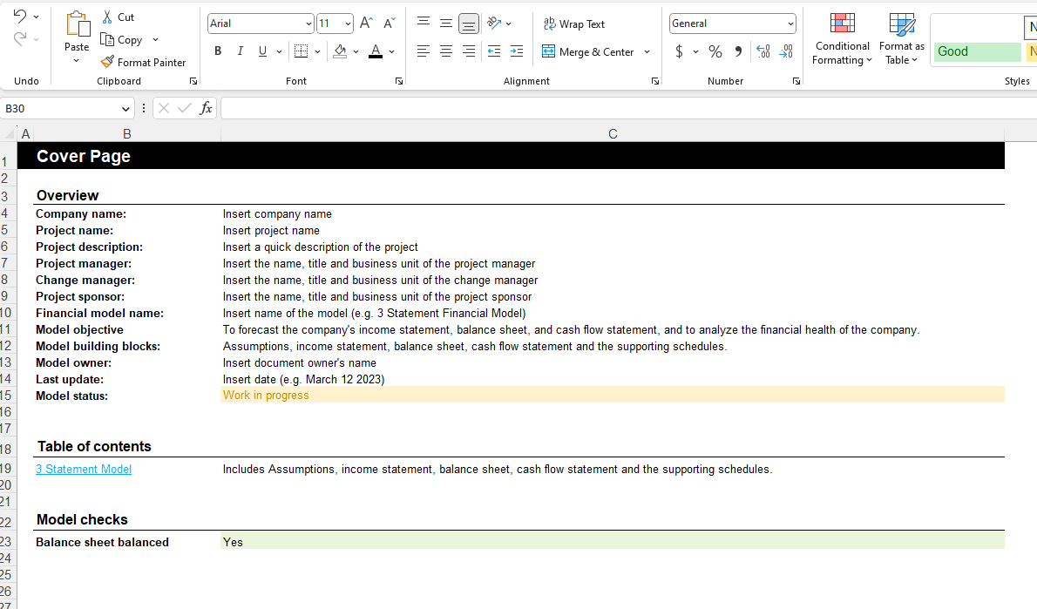
Let’s zoom on each building block Cover
Real-life Example

Slide 21
Let’s zoom on each building block Inputs
Inputs are the specific variables and data points that are used to build a model. Inputs can be based on a wide range of sources, including financial statements, market research, and management guidance.
Examples of inputs in financial modeling include:
Historical financial statements: Inputs may include past revenue, expenses, and earnings data, as well as information on the company's assets, liabilities, and equity.
Market research: Inputs may include data on market size, growth rates, and trends, as well as information on the company's competitors and the overall industry landscape.
Management guidance: Inputs may include guidance from the company's management on key assumptions and expectations for future performance, such as growth rates and capital expenditure requirements.
Economic data: Inputs may include macroeconomic data, such as inflation rates and interest rates, which can impact the financial performance of the company.
Other financial metrics: Inputs may include other financial metrics, such as customer acquisition costs or customer lifetime value, which can be used to generate more accurate forecasts.
Inputs are critical to the accuracy and usefulness of the model. It is important to ensure that all inputs are properly documented and that any sources of uncertainty or risk are appropriately accounted for. Additionally, sensitivity analysis can be conducted on inputs to test the impact of different assumptions on the output generated by the model.

Slide 22
Let’s zoom on each building block Drivers
Drivers are the key inputs that have the most significant impact on the output of the model.
Examples of drivers in financial modeling include:
Revenue growth rate: This is the rate at which a company's revenue is expected to grow over time. It is a key driver of the company's financial performance and is influenced by a wide range of factors, such as market demand, pricing, and competition.
Cost of goods sold (COGS): This is the cost of producing a company's products or services. It is a critical driver of profitability and can be influenced by factors such as raw material costs, labor costs, and production efficiency.
Operating expenses: These are the costs associated with running a company, such as salaries, rent, and marketing expenses. They can be a significant driver of profitability and can be influenced by factors such as growth plans, pricing strategies, and efficiency initiatives.
Capital expenditures (CAPEX): These are the investments a company makes in long-term assets, such as property, plant, and equipment. They are a key driver of future growth and can be influenced by factors such as market demand, competitive pressures, and technological advancements.

Slide 23
Let’s zoom on each building block Income statement
An income statement, also known as a profit and loss (P&L) statement, is a financial statement that reports a company's revenues, expenses, and net income for a given period. The income statement is an important component of a company's financial statements, which also includes the balance sheet and statement of cash flows.
The income statement typically includes the following elements:
Revenue: This is the total amount of money earned by the company from the sale of goods or services during the period.
Cost of goods sold (COGS): This is the cost of producing or purchasing the products or services sold by the company.
Gross profit: This is the difference between revenue and COGS, and represents the profit before deducting operating expenses.
Operating expenses: These are expenses incurred in the normal course of business, such as salaries, rent, marketing expenses, and office supplies.
Operating income: This is the difference between gross profit and operating expenses, and represents the profit before interest and taxes.
Interest expense: This is the cost of borrowing money, such as interest on loans or bonds.
Income tax expense: This is the amount of taxes owed to the government on the company's income.
Net income: This is the final profit or loss after deducting all expenses, including interest and taxes.
The income statement is an important tool for financial modeling because it provides a snapshot of a company's financial performance over a specific period. Analysts can use the income statement to calculate various financial ratios, such as gross margin and net profit margin, which can be used to evaluate a company's profitability and financial health. In addition, the income statement is often used as an input in forecasting models to project a company's future financial performance.

Slide 24
Let’s zoom on each building block Balance sheet
In financial modeling, a balance sheet is a financial statement that reports a company's assets, liabilities, and equity at a specific point in time.
The balance sheet typically includes the following elements:
Assets: These are the resources owned by the company, such as cash, accounts receivable, inventory, property, plant, and equipment.
Liabilities: These are the obligations of the company, such as accounts payable, loans, and other debts.
Equity: This is the difference between assets and liabilities, and represents the value of the company that belongs to its owners.
The balance sheet equation is Assets = Liabilities + Equity, which means that the total value of a company's assets must equal the sum of its liabilities and equity.
The balance sheet is an important tool for financial modeling because it provides a snapshot of a company's financial position at a specific point in time. Analysts can use the balance sheet to calculate various financial ratios, such as the debt-to-equity ratio and the current ratio, which can be used to evaluate a company's liquidity and financial health. In addition, the balance sheet is often used as an input in forecasting models to project a company's future financial position.

Slide 25
Let’s zoom on each building block Cash flow statement
The cash flow statement is a financial statement that reports the cash generated and used by a company during a specific period of time. It provides information about a company's operating, investing, and financing activities.
The cash flow statement is typically divided into three sections:
Operating activities: This section reports the cash inflows and outflows from a company's primary business operations, such as the cash received from customers and the cash paid to suppliers.
Investing activities: This section reports the cash inflows and outflows from a company's investments in long-term assets, such as property, plant, and equipment, and other investments.
Financing activities: This section reports the cash inflows and outflows from a company's financing activities, such as the cash received from issuing debt or equity and the cash paid for dividends or to repurchase shares.
The cash flow statement is important for financial modeling because it provides information about a company's ability to generate cash and whether it has enough cash to pay its bills and invest in future growth. It is also an important tool for forecasting a company's future cash flows and estimating its intrinsic value.

Slide 26
Let’s zoom on each building block Best practices for the 3 financial statements
Avoid too many calculations within the financial statements. It will simply the balancing exercise between the income statement, the balance sheet and the cash flow statement. For example, it is better to calculate the revenue in the revenue schedule, and then link the output to the income statement.
To ensure a smooth top to-bottom-flow, it is often recommended to order the 3 financial statements like this:
Income statement
Cash flow statement
Balance sheet
Indeed, the “Net Income” at the bottom of the income statement will end up at the top of the cash flow statement. And the “Ending cash balance” at the bottom of the cash flow statement will end up at the top of the balance sheet.
However, if you have a compelling reason, you may decide to change this order. For example you may decide to change this order if your company always presents their financial statements in a different order, or if the story line of your final presentation requires it.

Slide 27
Avoid too many calculations within the financial statements. It will simply the balancing exercise between the income statement, the balance sheet and the cash flow statement.
Cover
Inputs
Calculation
Outputs
Cover
Inputs
Income statement
Dashboard
Drivers
Balance sheet
Cash flow statement
Revenue schedule
Cost schedule
Working capital
For example, it is better to calculate the revenue in the revenue schedule, and then link the output to the income statement.
Depreciations
Debt & Interest
Free cash flow

Slide 28
Let’s zoom on each building block Revenue schedule
A revenue schedule is a table or spreadsheet that outlines a company's expected revenue for a specific period of time. It typically includes a breakdown of revenue by product or service, geography, or customer segment, and may also include information on pricing, volume, and growth rates.
The revenue schedule is an important component of financial modeling because it provides a basis for projecting a company's future revenue streams, which is essential for estimating future cash flows, profitability, and overall business performance. The revenue schedule can also be used to identify key drivers of revenue growth or decline, and to assess the impact of changes in pricing, volume, or market share.
When building a revenue schedule, it is important to use reliable data sources and to take into account a range of factors that may impact revenue, such as seasonality, economic trends, and competitive pressures.

Slide 29
Let’s zoom on each building block Cost schedule
A cost schedule is a table or spreadsheet that outlines a company's expected costs and expenses for a specific period of time. It typically includes a breakdown of costs by category, such as cost of goods sold, selling and administrative expenses, and research and development costs.
The cost schedule is an important component of financial modeling because it provides a basis for projecting a company's future expenses, which is essential for estimating profitability and overall business performance. The cost schedule can also be used to identify key drivers of cost changes.
When building a cost schedule, it is important to use reliable data sources and to take into account a range of factors that may impact costs, such as inflation, labor costs, and supplier costs. It is also important to ensure that the cost projections are consistent with other parts of the financial model, such as the income statement and cash flow statement. Finally, the cost schedule should be regularly reviewed and updated to ensure that it remains accurate and relevant over time.

Slide 30
For more details on the income statement, balance sheet, cash flow statement, revenue schedule and cost schedule, please refer to the folder “Financial Analysis”
Cover
Inputs
Calculation
Outputs
Cover
Inputs
Income statement
Dashboard
Drivers
Balance sheet
Cash flow statement
Revenue schedule
Cost schedule
Working capital
Depreciations
Debt & Interest
Free cash flow

Slide 31
Let’s zoom on each building block Working capital schedule
The working capital schedule is a detailed calculation of a company's working capital needs over a given period of time. Working capital refers to the funds a company needs to cover its day-to-day operational expenses, such as paying suppliers, covering payroll, and maintaining inventory.
The working capital schedule is typically created as part of a company's cash flow statement, which tracks the flow of cash into and out of the business over a given period of time. The schedule is usually broken down into several different components, including accounts receivable, accounts payable, and inventory.
The accounts receivable component of the working capital schedule tracks the money that a company is owed by its customers. This includes any outstanding invoices or payments that have not yet been received. The accounts payable component, on the other hand, tracks the money that a company owes to its suppliers or vendors. This includes any outstanding invoices or payments that have not yet been paid.
The inventory component of the working capital schedule tracks the value of the goods or materials that a company has on hand. This includes both finished goods and raw materials that have been purchased but not yet used.
By tracking these different components of working capital, the working capital schedule helps to ensure that a company has enough cash on hand to cover its operational expenses. It also helps to identify potential areas where the company may be able to improve its working capital management, such as by reducing its inventory levels or by improving its collections process for accounts receivable.

Slide 32

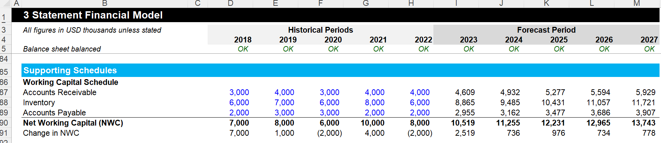
Let’s zoom on each building block Working capital schedule
Real-life Example

Slide 33
Let’s zoom on each building block Depreciation schedule
A depreciation schedule is a table or calculation that shows the amount of depreciation expense that a company will record on its financial statements over a given period of time. Depreciation is the process of allocating the cost of a long-term asset (such as property, plant, and equipment) over the useful life of that asset.
A depreciation schedule typically includes the following information:
Asset description: This includes a brief description of the asset being depreciated, such as a building or a piece of equipment.
Purchase price: This is the original cost of the asset when it was acquired by the company.
Useful life: This is the estimated length of time that the asset will be used by the company before it becomes obsolete or needs to be replaced.
Salvage value: This is the estimated value of the asset at the end of its useful life, or the amount that the company expects to receive if it sells the asset at the end of its useful life.
Depreciation method: This is the method that the company uses to calculate its depreciation expense. Common methods include straight-line depreciation, accelerated depreciation, and units-of-production depreciation.
Using this information, the depreciation schedule calculates the amount of depreciation expense that the company will record on its financial statements each year. This helps to ensure that the company is properly accounting for the cost of its long-term assets over their useful lives, and that it is not overstating its profits in any given year by failing to account for the cost of its assets.
Depreciation schedules can be useful for financial modeling because they help to provide a more accurate picture of a company's future financial performance. By accurately forecasting depreciation expenses, financial models can provide a more realistic assessment of a company's profitability and cash flow over time.

Slide 34
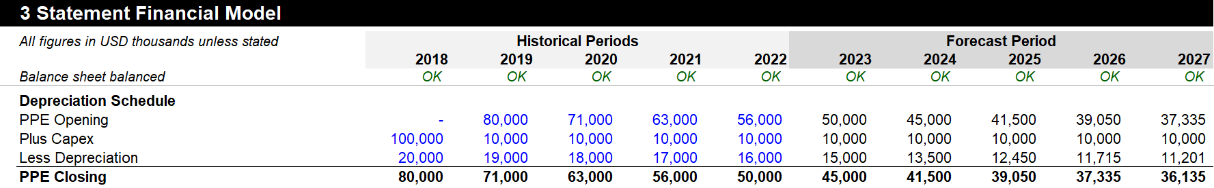
Let’s zoom on each building block Depreciation schedule
Real-life Example

Slide 35
Let’s zoom on each building block Debt and interest schedule
A debt and interest schedule is a table or calculation that shows the amount of debt that a company owes and the interest expense that it will pay on that debt over a given period of time. This schedule is important because debt is a common way that companies finance their operations and growth, and interest expense is a significant component of a company's overall expenses.
The debt and interest schedule typically includes the following information:
Debt description: This includes a brief description of the debt being analyzed, such as a bank loan, bond issue, or lease obligation.
Principal amount: This is the original amount of the debt when it was incurred by the company.
Interest rate: This is the rate of interest that the company is paying on the debt.
Payment frequency: This is the frequency with which the company is required to make payments on the debt, such as monthly or quarterly.
Term: This is the length of time over which the company is required to repay the debt.
Amortization schedule: This is the schedule that shows how the principal balance of the debt will be repaid over time.
Using this information, the debt and interest schedule calculates the amount of interest expense that the company will record on its financial statements each period. This helps to ensure that the company is properly accounting for its debt obligations and interest expenses, which are important factors in assessing a company's overall financial health.
Debt and interest schedules can be useful for financial modeling because they help to provide a more accurate picture of a company's future financial performance. By accurately forecasting interest expenses, financial models can provide a more realistic assessment of a company's profitability and cash flow over time, which can help investors and analysts make informed investment decisions.

Slide 36
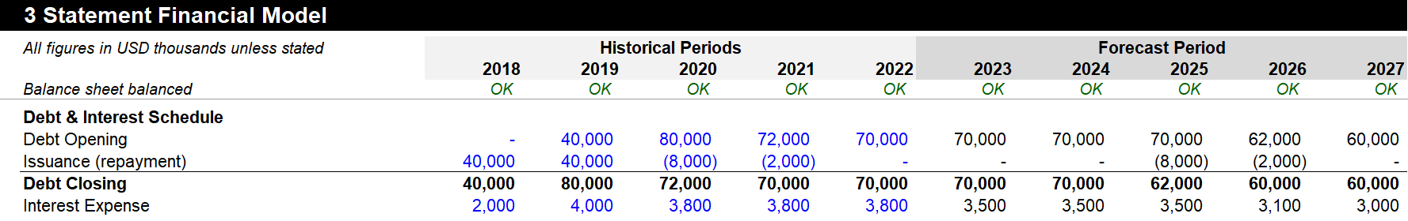
Let’s zoom on each building block Debt and interest schedule
Real-life Example

Slide 37
Let’s zoom on each building block Free cash flow (FCF)
Free cash flow (FCF) is a measure of a company's cash flow that represents the amount of cash generated by the company's operations after accounting for capital expenditures (money spent on property, plant, and equipment) and changes in working capital.
The formula for free cash flow is as follows:
FCF = Operating cash flow - Capital expenditures
Or, alternatively:
FCF = Net income + Depreciation and amortization - Changes in working capital - Capital expenditures
Free cash flow is an important metric in financial modeling because it represents the cash that is available for a company to use for various purposes, such as paying dividends, repurchasing stock, paying off debt, or investing in growth opportunities. It is often used as a key input in valuation models to estimate a company's intrinsic value.
To create a free cash flow forecast in a financial model, the analyst will typically need to forecast the company's operating cash flow, capital expenditures, changes in working capital, and any other relevant cash flow items. These forecasts are typically based on historical data, industry trends, management guidance, and other relevant factors.
The resulting free cash flow forecast can then be used to evaluate a company's financial performance and prospects, and to estimate its intrinsic value.

Slide 38
Let’s zoom on each building block Dashboard
In financial modeling, a dashboard typically includes charts, graphs, tables, and other visual elements that allow users to quickly and easily understand the output of a financial model.
The purpose of a dashboard is to provide an at-a-glance view of a company's financial performance, allowing decision-makers to quickly identify trends, spot potential issues, and make informed decisions. A dashboard can also be used to monitor progress against goals and targets, and to track key metrics over time.
Some common elements that might be included in a financial model dashboard include:
Revenue and expense trends over time
Key performance indicators (KPIs) such as profitability, liquidity, and solvency ratios
Budget vs. actual performance
Cash flow analysis
Balance sheet and income statement summary data
Other key metrics such as customer acquisition costs or churn rates
The specific design and layout of a financial model dashboard will depend on the needs of the users and the complexity of the financial model. The dashboard should be designed to be easily understood and navigated, and should present the information in a clear and concise manner.

Slide 39
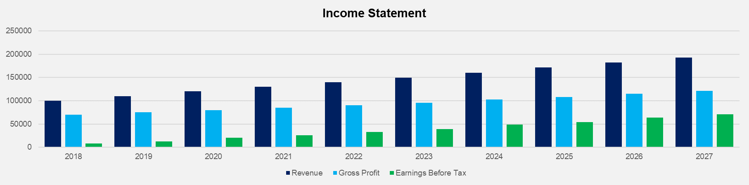
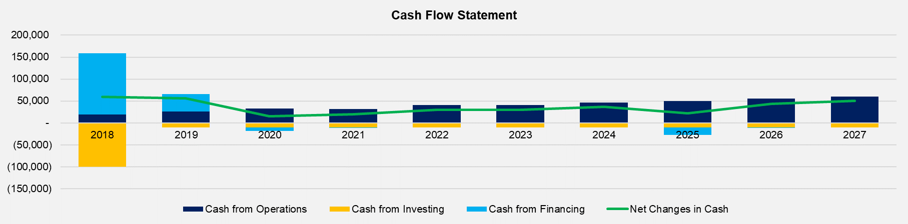
Let’s zoom on each building block Dashboard
Real-life Example

Slide 40
Table of contents
What is financial modeling?
What are the most used financial models?
How to design a financial model?
What are the main building blocks used to build a financial model?
How to format a financial model?
What are the key formulas to use in your financial model?
What are the main shortcuts used in financial modelling?
How to handle model circularity issues?

Slide 41
You can format a financial model correctly in 6 simple steps
Many model builders overlook model formatting. We believe it is a mistake to do so. Indeed, a financial model with a professional, clean and consistent formatting will allow you to make a good first impression, which will establish trust with your audience.
In order to achieve the best possible format for a financial model, we recommend to follow these 6 simple steps:
1.
Stacking schedules
2.
Freezing panes
3.
Column and row consistency
4.
Schedule format
5.
Cell labelling & format
6.
Page layout & printing

Slide 42
Let’s zoom on Step 1: Stacking schedules
1.
Stacking schedules
2.
Freezing panes
3.
Column and row consistency
4.
Schedule format
5.
Cell labelling & format
6.
Page layout & printing

Slide 43
Professionals usually like to organize schedules in 2 different ways
1
2
1 schedule per tab
Multiple schedules on top of each other in 1 tab

Slide 44
Advantages of both ways to organize schedules
1
2
1 schedule per tab
Multiple schedules on top of each other in 1 tab
This structure helps navigation, as the tabs a the bottom of the workbook serves as a table of content. However, when the model includes many different schedules & sheets, the navigation becomes more challenging, as most of the tabs will not appear at the bottom of the Excel workbook. This will force you to do some horizontal scrolling.
This structure is easier to check and often leads to less errors, as the stacked schedules can be easily connected by simply linking directly upwards or downwards within the tab (You need to make sure that the periods of each schedule are perfectly aligned).
This structure is also easier to follow.

Slide 45
We slightly prefer the structure 2 of staking schedules on top of each other in 1 tab
1
2
1 schedule per tab
Multiple schedules on top of each other in 1 tab
This structure helps navigation, as the tabs a the bottom of the workbook serves as a table of content. However, when the model includes many different schedules & sheets, the navigation becomes more challenging, as most of the tabs will not appear at the bottom of the Excel workbook. This will force you to do some horizontal scrolling.
This structure is easier to check and often leads to less errors, as the stacked schedules can be easily connected by simply linking directly upwards or downwards within the tab (You need to make sure that the periods of each schedule are perfectly aligned).
This structure is also easier to follow.

Slide 46
Let’s zoom on Step 2: Freezing panes
1.
Stacking schedules
2.
Freezing panes
3.
Column and row consistency
4.
Schedule format
5.
Cell labelling & format
6.
Page layout & printing

Slide 47
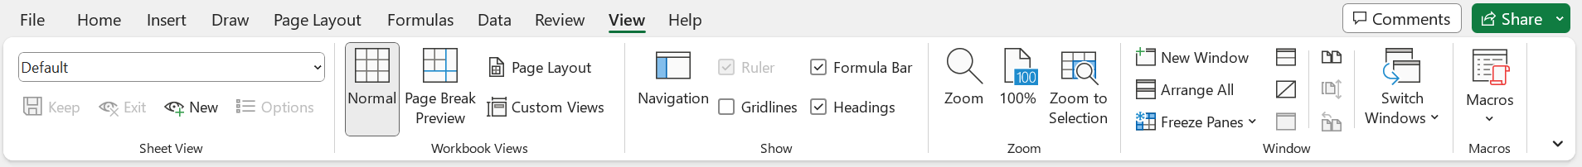
Freezing panes (1/2)
A good practice is to use the freeze panes option in the “View” tab of the Excel Ribbon:
Important information need to be placed in the freeze panes. For example, many model builders like to have in the freeze panes information such as:
The name of the Excel sheet
A sentence in italic about the format of most numbers in the model
Historical periods and forecast periods. Please note that sometimes, the words “Historical Periods” are replaced by the letter A (for “Actual”) added at the end of each year. sometimes, the words “Forecast Periods” are replaced by the letter F (for “Forecast”) added at the end of each year. That way, you only need 1 line instead of 2.

Slide 48
Freezing panes (2/2)
Sometimes, model builders also like to have in the freeze panes:
The corporate logo
A summary of the model checks or a “Check Model” alert indicating that at least one of the model checks has been tripped

Slide 49
Let’s zoom on Step 3: Column and row consistency
1.
Stacking schedules
2.
Freezing panes
3.
Column and row consistency
4.
Schedule format
5.
Cell labelling & format
6.
Page layout & printing

Slide 50
Column and row consistency
A consistent column structure within each worksheet is imperative. For example, if a column is used to show information about a specific period, then it needs to be kept consistent within the worksheet from top to bottom. Sometimes, model builders even go 1 step further by keeping the same columns between different worksheets. Though, this may not always be possible.
It is also a best practice to keep row consistency. For example, it is important to have the same formula used in a given row, from left to right. This make the model faster to build. For example, once you have the right formula in the first column, you can simply copy and paste the formula from left to right by:
Clicking on “CTRL C” to copy the formula
Select all the other columns by using the key “Shift and the arrow”
Copy the formula using “CTRL R”.
It is also easier to check, as you really need to only check 1 column. Once the column has been reviewed, you simply need to check for consistency across the rows.
Empty columns should be avoided. But empty lines can be used, especially between schedules or between sections within a schedule.
Row differences can easily be checked using the “CTRL \” shortcut. And column differences can easily be checked using the “CTRL SHIFT \” shortcut

Slide 51
Let’s zoom on Step 4: Schedule format
1.
Stacking schedules
2.
Freezing panes
3.
Column and row consistency
4.
Schedule format
5.
Cell labelling & format
6.
Page layout & printing

Slide 52
All major calculations in a model should be done inside of schedules
Most schedules should have 3 main sections:
Schedule XYZ
1. Input section
2. Calculation section
3. Output section
To increase clarity, we recommend to insert an empty row between the 3 sections of a schedule, and a couple of rows between each schedule.
To navigate easily between the different schedules, you can use the “page down” and “page up” keys

Slide 53
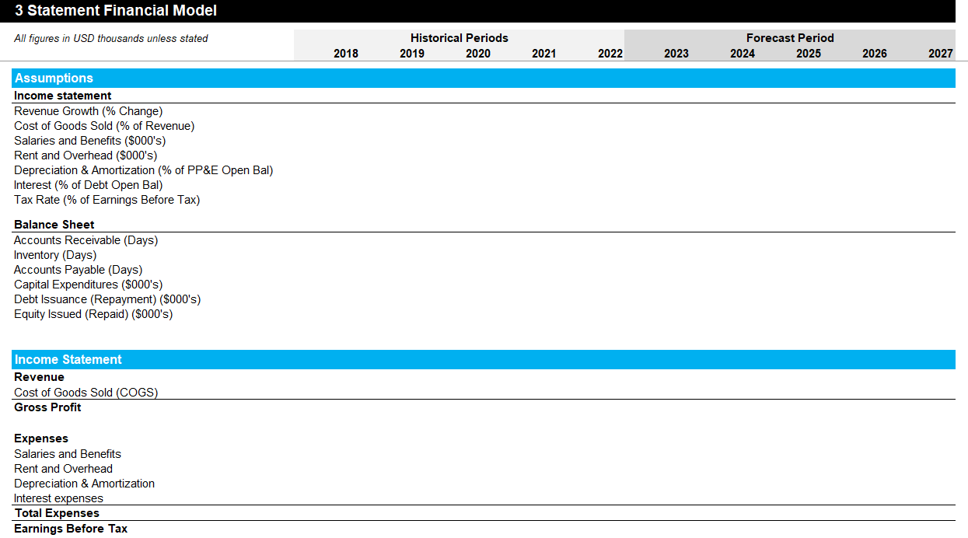
There are multiple ways to facilitate navigation in a tall stack of schedules (1/2)
The most obvious way to easily navigate between the different schedules is to use the “page down” and “page up” keys.
You can also decide to put a space in the column A at the start of each schedule, that will play the role of a “Stop”. That way, wherever you are in the financial model, you can press “home” to go back to the column A, and then you can press CTRL Arrow down, or CTRL Arrow up to navigate between each schedule:
Put a space in this cell
Put a space in this cell

Slide 54
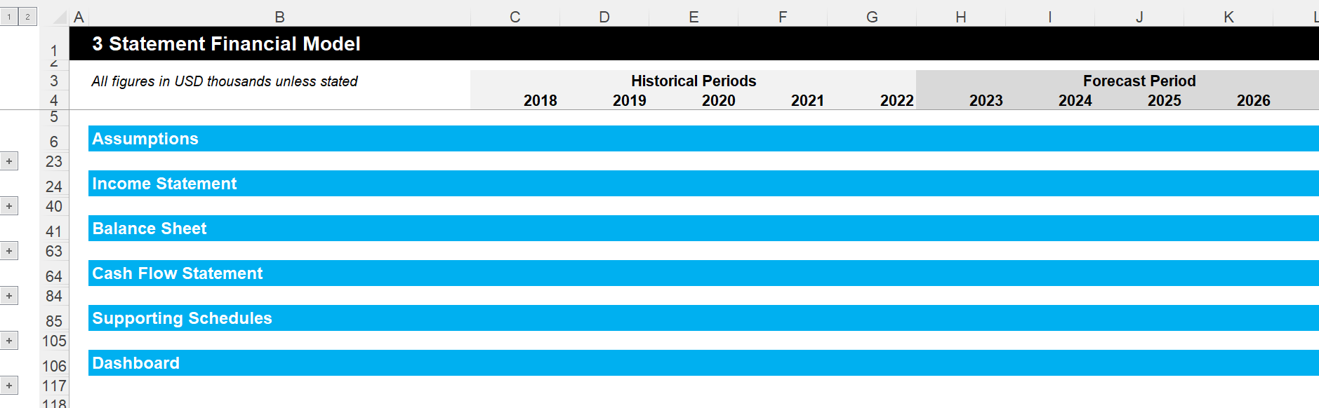
There are multiple ways to facilitate navigation in a tall stack of schedules (2/2)
On top of the navigational column, you can also group rows by:
Selecting the rows below a schedule
Clicking on the tab “Data”
Clicking on “Outline”
Clicking on “Group”
If you click on the level “1”, you will collapse the rows and only see the title of each schedule, which will basically be your table of contents.
If you click on the level “2”, you will see everything
You can also decide to only see the details of 1 schedule by clicking on “+”

Slide 55
Let’s zoom on Step 5: Cell labelling & format
1.
Stacking schedules
2.
Freezing panes
3.
Column and row consistency
4.
Schedule format
5.
Cell labelling & format
6.
Page layout & printing

Slide 56
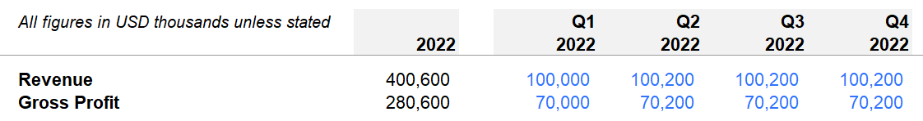
Consistent Cell labelling & format (1/3)
Whenever possible try to have the same label for the cells which are linked together. This will make the model easier to read and will facilitate the review process.
Try to avoid lower case formatting, as it looks incomplete and unprofessional. Upper case formatting, sentence case formatting and title case formatting can be used, but make sure that their use is consistent across the model. For example, you may decide to use Upper case formatting for each schedule title, and title case formatting for all the other labels. Try to avoid mixing sentence case formatting and title case formatting, as they are difficult to differentiate.
Use a blue font for input, and use a black font for formulas or a links:
Choose a professional font type such as “Arial” and apply it throughout the model. Only the font color and the font size can be adjustede in the model to highlight sections or convey key metrics.
Try to avoid using long formula. It is better to break down the long formula into smaller formulas spread across multiple rows, even if that means that you will end up with longer schedules. In other words, it is better to have long and simple schedules than compact and difficult to follow schedules. This is even more true when the model is printed, as the formulas will not be visible to the audience.

Slide 57
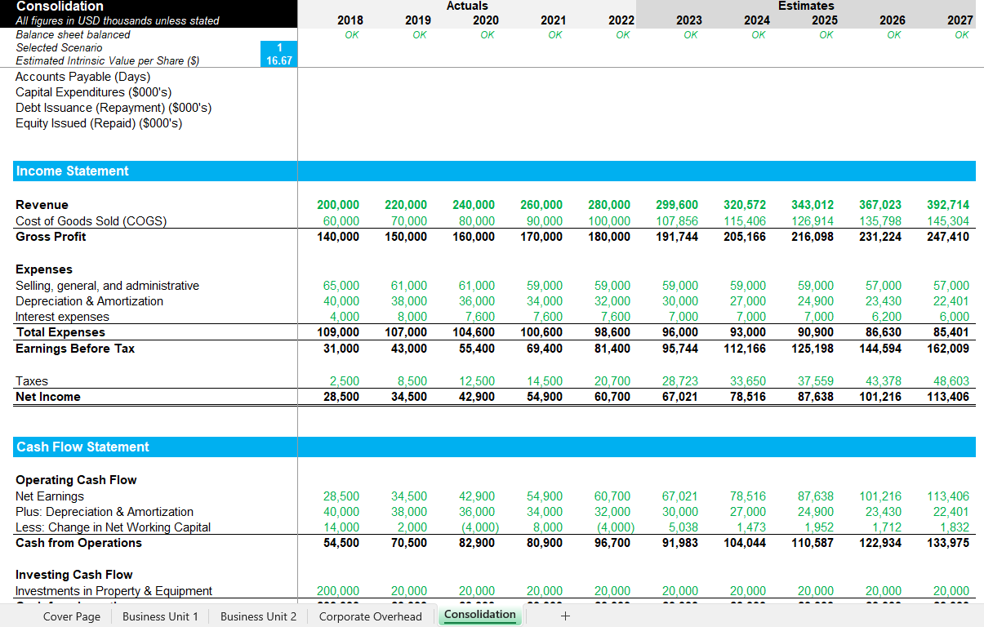
Consistent Cell labelling & format (2/3)
Sometimes model builders like to use a green font in cells that have been linked to a different tab. We also like to do so. For example, below the green cell of the tab “Consolidation” includes a formula that adds numbers from the 3 previous tabs.

Slide 58
Consistent Cell labelling & format (2/2)
It is also important to define how the numbers will be displayed. A best practice is to display numbers with a thousands separator, negative numbers in bracket, and zeroes with a dash:
To do that, you simply need to:
Highlight your cells
Click left
Click on “Formal cells”
Click on “custom”
Select the format you want or if you like our format, you can copy paste _(#,##0_);(#,##0);_(-_);_(@_) in the field “Type”
We recommend avoiding currency symbols to avoid a busy looking model. Instead, we simply right on the top left a sentence such as “All figures in USD thousands unless stated”. We also like to add a “Unit” column, which will be filled only when the figures of a row are not in “in USD thousands”. For example, the figure of a specific row may represent “units” or “USD/Unit”.

Slide 59
You can format a financial model correctly in 5 simple steps
1.
Stacking schedules
2.
Freezing panes
3.
Column and row consistency
4.
Schedule format
5.
Cell format
6.
Page layout & printing

Slide 60
Let’s zoom on Step 6: Page layout & printing
1.
Stacking schedules
2.
Freezing panes
3.
Column and row consistency
4.
Schedule format
5.
Cell labelling & format
6.
Page layout & printing

Slide 61
Page layout & printing
The page layout of your models needs to facilitate the printing of the model. Or if you want to reduce the use of paper, the file should be configured to be saved as a PDF file. This allows users to quickly open the file and save it with a locked in presentation format.
This will allow the model to be effectively presented to your stakeholders.
To ensure full transparency and make sure that senior leaders have all the information to make good decisions, all the building blocks of the model should be included in the printout. However, the most important building blocks, such as the dashboard, drivers and inputs, should be prioritized to the first pages of the print. We usually recommend the following order:
Cover page
Dashboard
Drivers
Inputs
Calculations

Slide 62
Table of contents
What is financial modeling?
What are the most used financial models?
How to design a financial model?
What are the main building blocks used to build a financial model?
How to format a financial model?
What are the key formulas to use in your financial model?
What are the main shortcuts used in financial modelling?
How to handle model circularity issues?

Slide 63
A Financial Model essentially uses the following 12 formulas:
TRIM
LOWER
UPPER
PROPER
LEFT
RIGHT
MID
&
ROUND
ROUNDUP
ROUNDOWN
MATCH
INDEX
MATCH AND INDEX COMBINED
SUMPRODUCT
IF
SUMIF
INDIRECT
ADDRESS

Slide 64
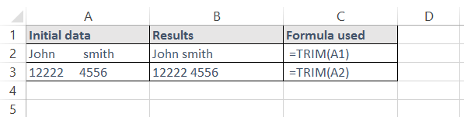
TRIM
Description
The TRIM function removes all spaces between words and numbers except for single spaces
It is used to clean up data and ensure consistency
Syntax
=TRIM(text)
Example

Slide 65
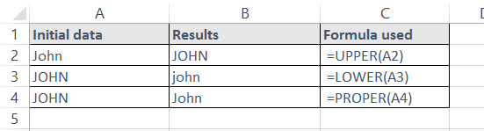
LOWER / UPPER / PROPER
Description
These text functions change the capitalisation of text to either all lower case, all capitals, or first letter upper case and all other letters lower case
Syntax
=UPPER(Text)
=LOWER(Text)
=PROPER(Text)
Example

Slide 66
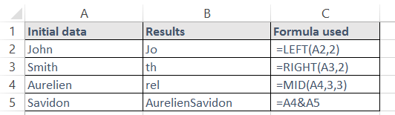
LEFT / RIGHT / MID / &
Description
These functions are used to manipulate and combine text and numbers
Syntax
=LEFT(Text, Number of characters to be provided)
=Right(Text, Number of characters to be provided)
=Mid(Text, Initial character to count from, Number of characters to be provided)
=CellX&CellY
Example

Slide 67
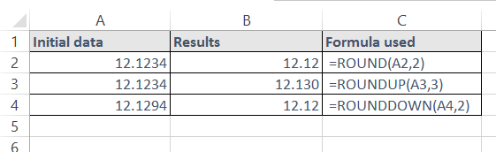
ROUND / ROUNDUP / ROUNDOWN
Description
These functions round your number according to the conditions you specify
Syntax
=ROUND(Number to be rounded, Number of digits)
=ROUNDUP(Number to be rounded, Number of digits)
=ROUNDDOWN(Number to be rounded, Number of digits)
Example

Slide 68
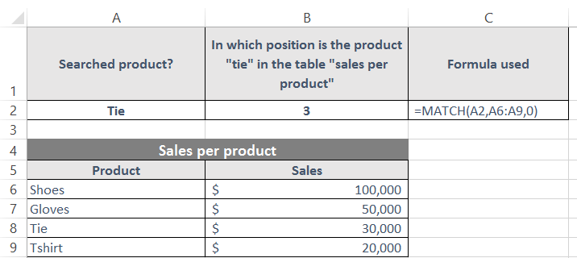
MATCH
Description
The MATCH function looks for an item in a list and returns its position in the list
It can be used for both text and numbers
The function can look for an exact or approximate match
Syntax
=MATCH(WhatToLookFor,WhereToLook,TypeOfMatch)
WhatToLookFor – The value to search for
WhereToLook – The range of values to search in
TypeOfMatch – Either 0, 1 or -1
0 – Looks for an exact match
1 – Looks for an exact match, or the next lowest number if no exact match exists
-1 – Looks for an exact match, or the next highest number if no exact match exists
Example

Slide 69
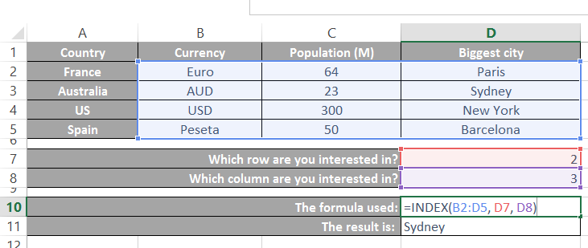
INDEX (1/2)
Description
The INDEX function picks a value from a range of data by looking down a specified number of rows, and then across a specified number of columns
It can be used with a single block of data, or non-continuous blocks
Syntax
=INDEX(RangeToLookIn,RowCoordinate,ColumnCoordinate)
RangeToLookIn – The range of cells to look in
RowCoordinate – The row coordinate to look for
ColumnCoordinate – The column coordinate to look for
Example

Slide 70
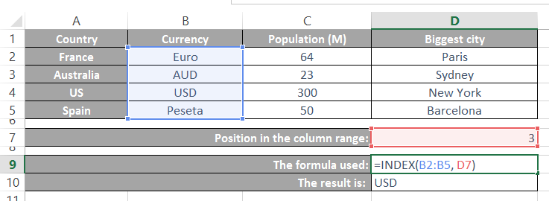
INDEX (2/2)
Description
The INDEX function can also be used with 1 coordinate instead of 2. In that case the RangeToLookIn needs to be either a single column or row
Syntax
=INDEX(RangeToLookIn,Coordinate)
Example

Slide 71
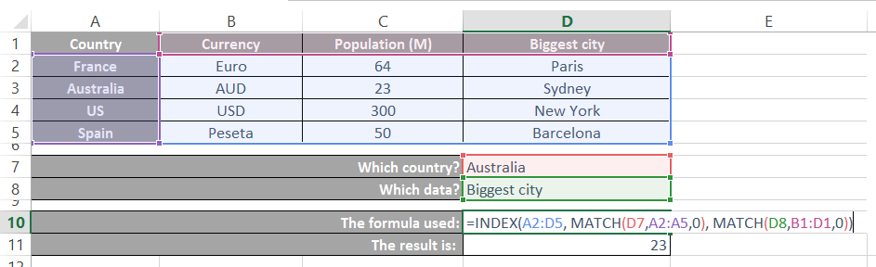
INDEX & MATCH combined
Description
INDEX and MATCH can be used together to look up a value from a table
2 MATCH functions are used to return both the row and column coordinates of the value
Then an INDEX function is used to look up the value from the table
Syntax
=INDEX(DataRange,MATCH(RowLookup,RowRange,0),MATCH(ColLookup,ColRange,0))
DataRange – The data range to look in
RowLookup – The row name to look up
RowRange – The data range containing row names
ColLookup – The column name to look up
ColRange – The data range containing column names
Example

Slide 72
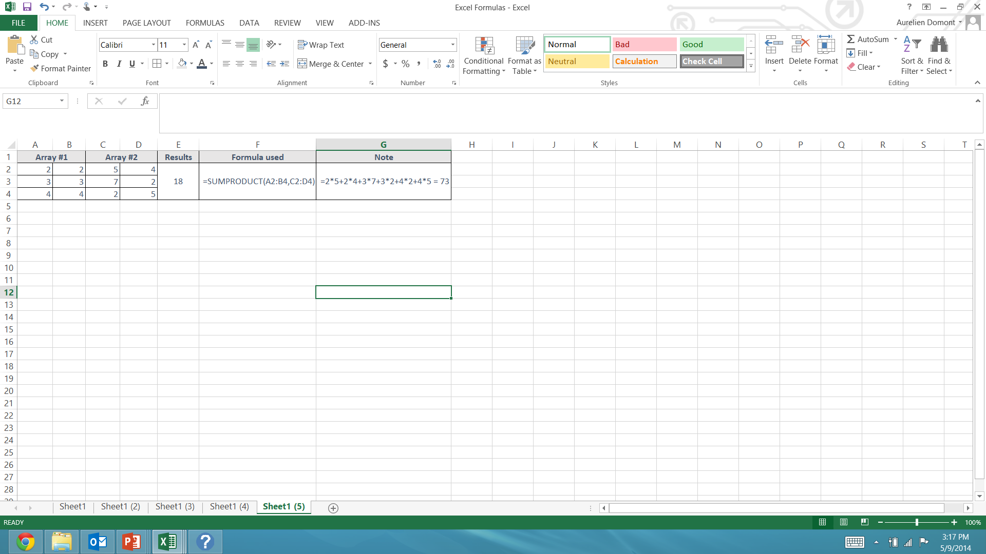
SUMPRODUCT
Description
Multiplies corresponding components in the given arrays, and returns the sum of those products
Syntax
=SUMPRODUCT(array1, array2,...)
Example

Slide 73
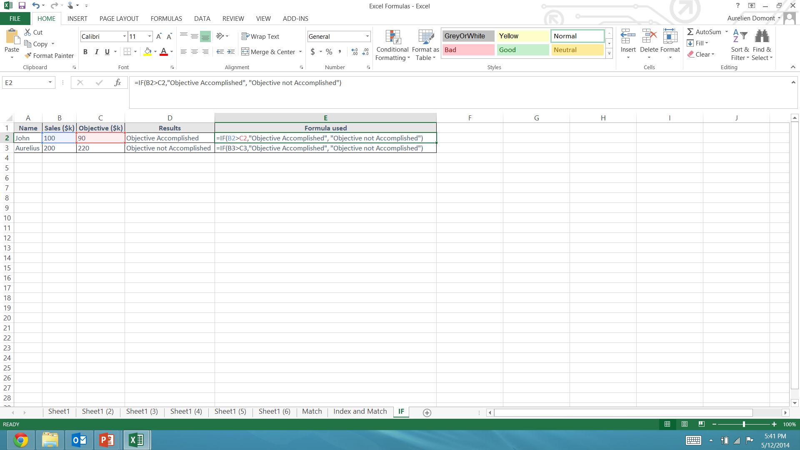
IF
Description
This function tests a condition
If the condition is met it is considered to be TRUE
If the condition is not met it is considered as FALSE
Depending upon the result, one of two actions will be carried out
Syntax
=IF(Condition, Action If True, Action If False)
The Condition is usually a test of two cells, such as A1=A2.
The “Action If True” and “Action If False” can be numbers, text or calculations
Example
The formula “IF” indicates in column D who has reached their objective:

Slide 74
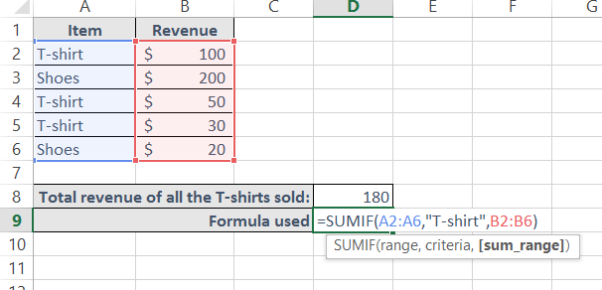
SUMIF
Description
This function sums the value of items which match the criteria set by the user
Syntax
=SUMIF(RangeOfThingsToBeExamined,CriteriaToBeMatched,RangeOfValuesToTotal)
Example
The formula “SUMIF” indicates in cell D8 the total revenue of all the t-shirts sold:

Slide 75
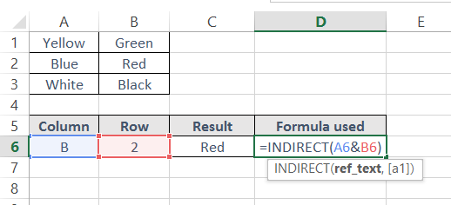
INDIRECT
Description
This function returns the contents of a cell, given the cell reference
Be careful if a cell is moved or a new row is inserted, as the cell references will not automatically update
Syntax
=INDIRECT(CELLREF)
Example
The INDIRECT formula returns in C6 the content of cell B2

Slide 76
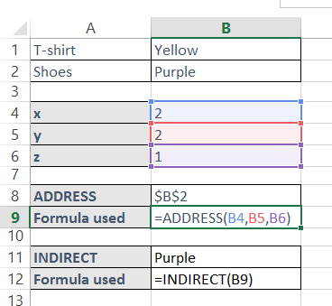
ADDRESS
Description
The address function returns the reference of a cell, given numerical coordinates.
This allows the cell reference to be modified by performing operations (i.e., add or subtract) in the numerical co-ordinates
Syntax
=ADDRESS(x,y,z)
x and y are integers that describe the co-ordinates of a cell (i.e., ADDRESS(1,1) will return “A1”)
z is an integer between 1 and 4 which determines whether absolute or relative referencing is used, i.e.
Z | Definition | Example
1 | Absolute | $A$1
2 | Relative column / Absolute row | A$1
3 | Absolute column / Relative row | $A1
4 | Relative | A1
Example
The ADDRESS formula returns the cell ref $B$2
The INDIRECT formula returns the content of cell B2

Slide 77
Table of contents
What is financial modeling?
What are the most used financial models?
How to design a financial model?
What are the main building blocks used to build a financial model?
How to format a financial model?
What are the key formulas to use in your financial model?
What are the main shortcuts used in financial modelling?
How to handle model circularity issues?

Slide 78
Main shortcuts used in financial modelling
Excel shortcuts can greatly speed up the financial modeling process, making it easier to navigate, manipulate, and analyze data. Here are some of the most common Excel shortcuts used in financial modeling:
CTRL+C, CTRL+V - Copy and paste values or formulas.
CTRL+Z - Undo the last action.
CTRL+Y - Redo the last action.
F2 - Edit the contents of the active cell.
CTRL+; - Insert the current date into a cell.
CTRL+SHIFT+: - Insert the current time into a cell.
ALT+= - Automatically sum a range of cells.
CTRL+SHIFT+$ - Format cells as currency.
Ctrl + Shift + &: Apply border to a selected cell or range of cells.
Ctrl + D - Duplicate the contents of a selected cell down a column.
Ctrl + R - Duplicate the contents of a selected cell across a row.
CTRL+SHIFT+# - Format cells as a number.
CTRL+SHIFT+@ - Format cells as a time.
CTRL+SHIFT+% - Format cells as a percentage.
F4 - Repeat the last action.
CTRL+SHIFT+ENTER - Enter an array formula.
CTRL+1 - Open the format cells dialog box.
ALT+ENTER - Insert a line break within a cell.
Ctrl + Shift + L - Apply a filter to a selected column or range of columns.
Ctrl + Page Up / Page Down - Switch between worksheets in a workbook.
By using these Excel shortcuts, financial analysts and modelers can save time and increase productivity, allowing them to focus on analyzing and interpreting financial data.

Slide 79
Table of contents
What is financial modeling?
What are the most used financial models?
How to design a financial model?
What are the main building blocks used to build a financial model?
How to format a financial model?
What are the key formulas to use in your financial model?
What are the main shortcuts used in financial modelling?
How to handle model circularity issues?

Slide 80
Model circularity Overview
Circularity, also known as circular references, occurs in a financial model when a formula refers back to a cell that depends on the value of the formula cell. This can result in incorrect results or an infinite loop in the calculation process.
It is important to note that while circular references can be problematic, they are not always bad. In some cases, circular references may be intentional and necessary for the financial model to work correctly. However, it is generally best practice to avoid circular references as much as possible and to resolve them when they do occur.

Slide 81
Model circularity Common example: Loop that flows through the cash schedule
A company that has a cash balance will earn interest income, which has a positive effect on net income
Net income flows into the cash flow statement and leads to a higher ending cash balance.
The higher ending cash balance has a positive impact on the interest income (This is due to the fact that interest income is calculated based on the average of the beginning and ending balance multiplied by the interest rate).
The higher interest income flows back up to the income statement to begin the loop again.

Slide 82
Model circularity Option 1: Switch on iterative calculations
You can switch on iterative calculations by:
Clicking on File
Clicking on Options
Clicking on Formula
Check the box “Enable iterative calculation”
What we're doing here is asking Excel to continue to calculate until the values converge on a solution.
The option is easy to implement and works correctly in many situations. But it also have some issues:
Excel will warn you the first time you introduce a circularity. If you introduce a second circularity, you will not receive any warning.
Each additional circularity will slow down your model.
Using iterative calculation to resolve a circularity requires a convergent solution. This is sometimes not the case, and so you can have a model that does not converge on a stable output. Every time you calculate the model, you get different results.
Activating iterative calculations happens at the application level, meaning that all open workbooks will run in iterative mode.

Slide 83
Model circularity Option 2: Change the model structure to remove the circularity
This is sometimes possible, but not always. If possible, this is the preferred option, as it will remove the circularity from Excel.

Slide 84
Model circularity Option 3: Goal seek and VBA macros
Goal seek and VBA macros are extremely powerful tools in Excel. However, they are considered static procedures. If the inputs change, the procedures have to be repeated. Therefore, their use to solve circularity problems will put the user at the mercy of his/her memory to remember when to execute the macro or initiate the goal seek procedure.

Slide 85
Thanks for your attention!
www.domontconsulting.com

